Slide 1

SMART INTERNZ- RSIP PROGRAM
Smart Agriculture based on Internet Of Things.
~by C.kailash,
Student, Rathinam college of arts&science,Coimbatore.

Slide 2
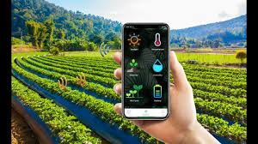
The application UI developed for smart agriculture based on IOT includes the features :-
Live weather details about the selected location.
Live temperature, humidity , soil moisture details about the farm land.
Online control over Irrigation pumps, motors.
Online control over Lights.

Slide 3
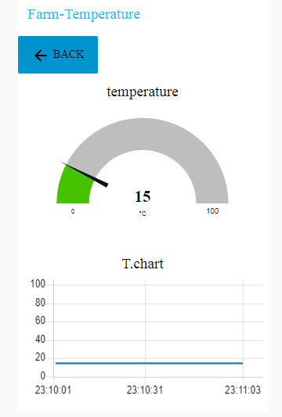
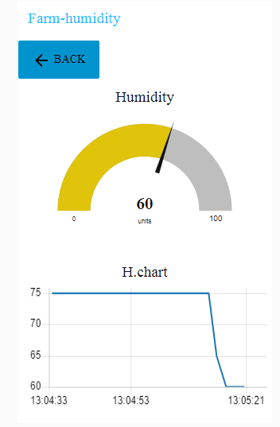
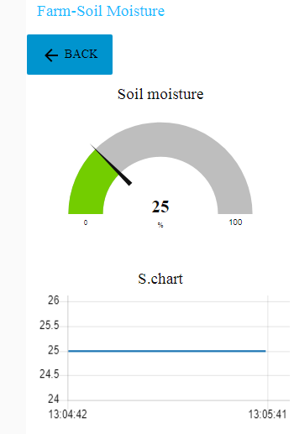
The temperature, humidity moisture levels are displayed as gauges and their variations based on time are shown in a line chart provided below them.

Slide 4
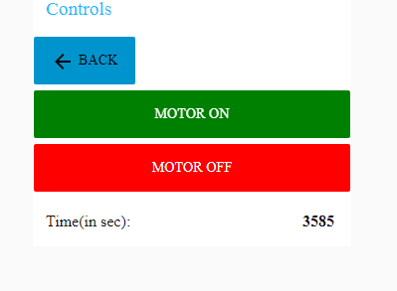
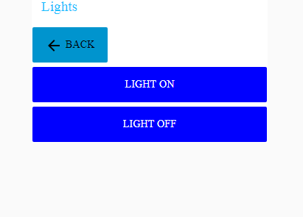
The light and motor controls facilitates on & off.
The motor is set with an automatic half an hour timer.
The farmer can set the motor run time .
An default alert is sent to the mobile when the motor had run for 15 mins.
Turning the lights on and off are carried out by the buttons of “Lights” section

Slide 5
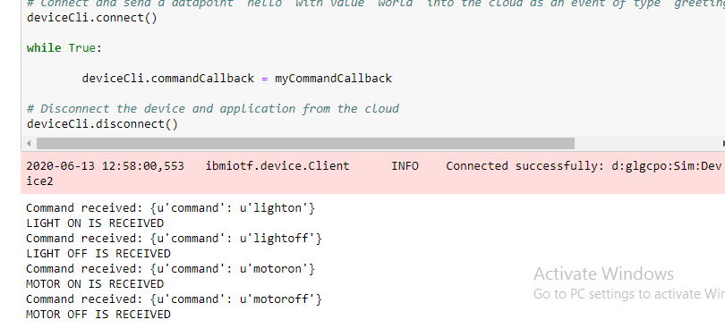
Command received by python:
The command received at python terminal given at the dashboard syncs correctly.
The commands are propagated in a precise a manner.

Slide 6
CONCLUSION:
The application made in the Node-Red platform works perfectly.
An practical application done at the fields is most likely to work great in the real-life scenario.
The application UI made has met it’s purpose by the features of live monitoring farm status and irrigation pump, light controls.
Thanks !

